Slide 2
ANOVA & Multiple comparisons with no correction

Slide 3
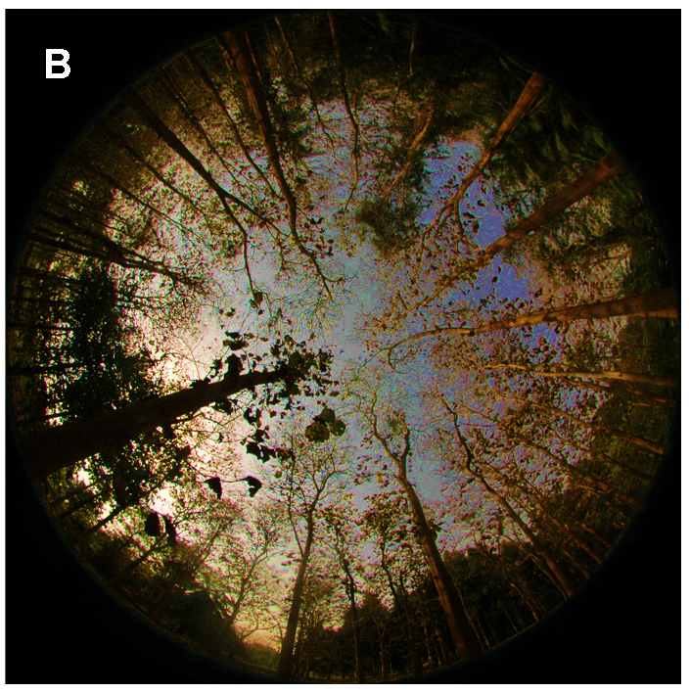
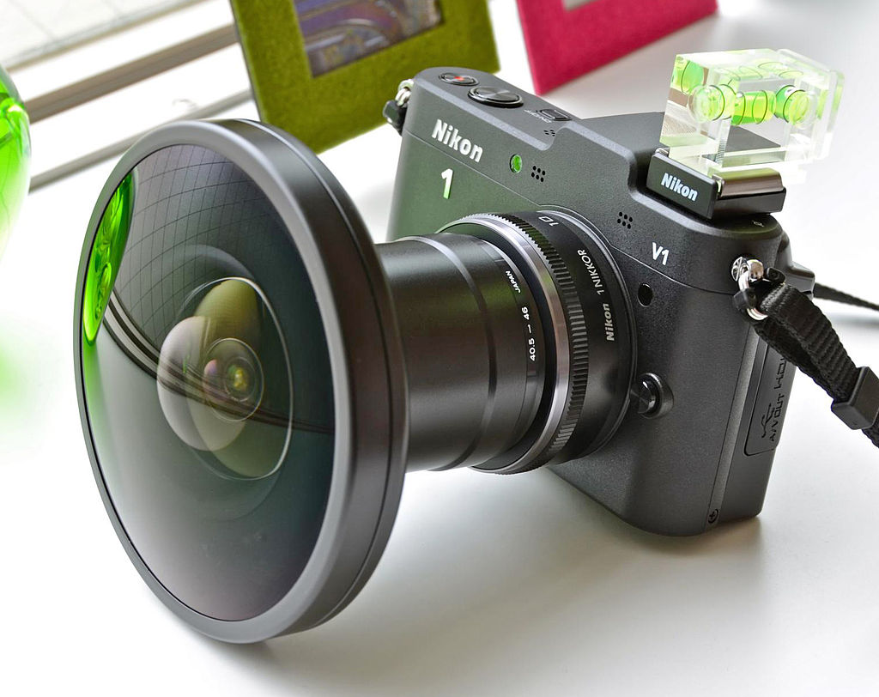
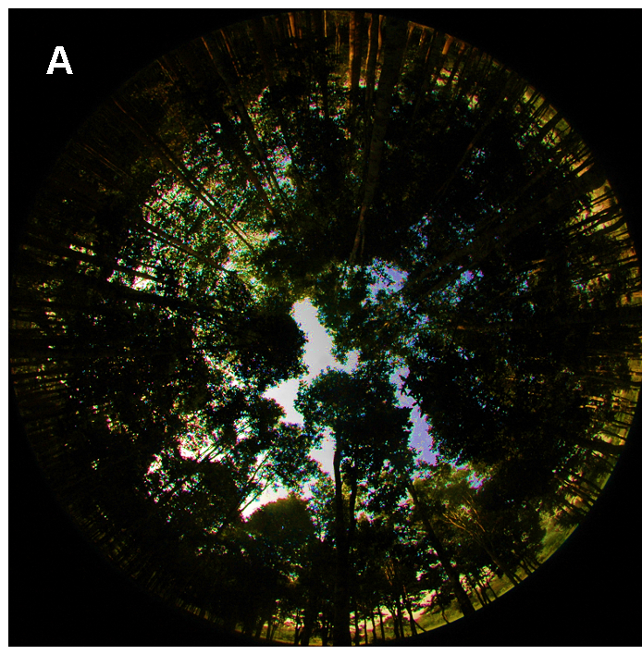
Fisheye photographs & canopy closure
(hemispheric photo)
Glathorn & Beckschäfer 2014 PLOS

Slide 4
Open canopy
Closed canopy
Glathorn & Beckschäfer 2014 PLOS

Slide 5
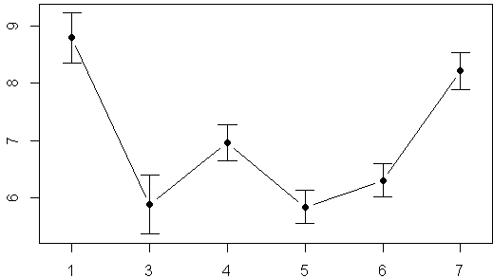
Canopy closure above 6 forest plots
More light
How open is canopy at each plot?
Less light
Error bars = 95%CI
Plot 1
Plot Number

Slide 6

Canopy closure above 6 forest plots
More light
How open is canopy at each plot?
Less light
Error bars = 95%CI
Plot 1
Plot Number

Slide 7
Canopy closure above 6 forest plots
Open
More light
How open is canopy at each plot?
Closed
Less light
Error bars = 95%CI
Plot 1
Plot Number

Slide 8
Canopy closure above 7 forest plots
More light
Should I use consider these planned or un-planned?
How open is canopy at each plot?
Less light
Error bars = 95%CI
Plot 1
Plot Number

Slide 9
Canopy closure above 7 forest plots
Should I use consider these planned or un-planned?
1)Experiment was not designed to test this question
2)Am going to carry out all possible comparisons
More light
How open is canopy at each plot?
Less light
Error bars = 95%CI
Plot 1
Plot Number

Slide 10
Canopy closure above 7 forest plots
Should I use consider these planned or un-planned?
1)Experiment was not designed to test this question
2)Am going to carry out all possible comparisons
More light
How open is canopy at each plot?
Less light
Error bars = 95%CI
Plot 1
Plot Number

Slide 11
Canopy closure above 7 forest plots
Should I use consider these planned or un-planned?
1)Experiment was not designed to test this question
2)Am going to carry out all possible comparisons
Most ecologists would consider this an after-the-fact UN-planned set of comparison
More light
How open is canopy at each plot?
Less light
Error bars = 95%CI
Plot 1
Plot Number

Slide 12
Canopy closure above 7 forest plots
Should I use consider these planned or un-planned?
1)Experiment was not designed to test this question
2)Am going to carry out all possible comparisons
Most ecologists would consider this an after-the-fact UN-planned set of comparison
Therefore need to “correct” for multiple comparisons
More light
How open is canopy at each plot?
Less light
Error bars = 95%CI
Plot 1
Plot Number

Slide 13
Example analysis: Canopy openness multiple comparisons
R tools
lm()
anova()
pairwise.t.test()

Slide 14
4 steps
1) Fit models w/ lm()
2) Compare models with anova()
3) Evaluate models (interpret p-value)
4) Pairwise comparisons w/ pairwise.t.test(), p.adjusted = “none”
4a) uncorrected
4b) corrected

Slide 15
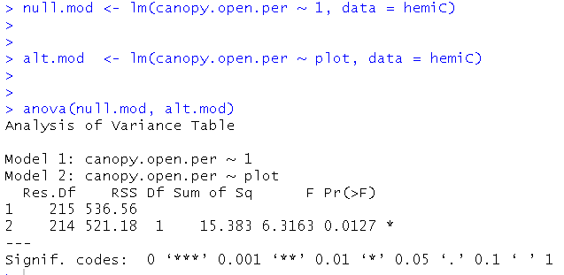
Example analysis: Canopy openness multiple comparisons
Step 1: Fit models
1

Slide 16
Example analysis: Canopy openness multiple comparisons
Step 2: compare models (omnibus test)
2

Slide 17
Example analysis: Canopy openness multiple comparisons
Step 3: evaluate models (omnibus test)
3

Slide 18
Example analysis: Canopy openness multiple comparisons
Step 3: evaluate models (omnibus test)
3
Interpretation
At least 1 pair of means differ

Slide 19
Example analysis: Canopy openness multiple comparisons
Step 3: evaluate models (omnibus test)
3
Interpretation
At least 1 pair of means differ

Slide 20
Example analysis: Canopy openness multiple comparisons
Step 3: evaluate models (omnibus test)
3
vs

Slide 21
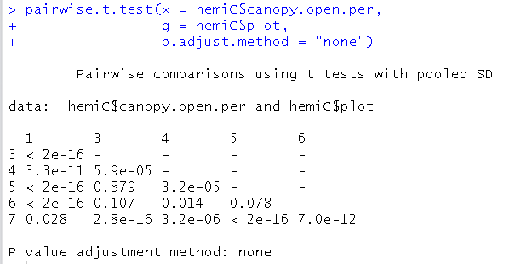
Example analysis: Canopy openness multiple comparisons
Step 4 vs. 1: pairwise comparisons, NO correction for multiple comparisons
4

Slide 22
Example analysis: Canopy openness multiple comparisons
Step 4 vs1: pairwise comparisons, NO correction for multiple comparisons
4
X: the numeric data
g: the column
w/grouping
Info it in
p.adjust.method: method for correcting p-values for multiple-comparisons
“none” = “don’t correct”

Slide 23
Example analysis: Canopy openness multiple comparisons
Step 4 vs1: pairwise comparisons, NO correction for multiple comparisons
4
X: the numeric data
g: the column
w/grouping
Info it in
p.adjust.method: method for correcting p-values for multiple-comparisons
“none” = “don’t correct”

Slide 24
Example analysis: Canopy openness multiple comparisons
Step 4 vs 1: pairwise comparisons, NO correction for multiple comparisons
-P-values for each & every comparison
-R doesn’t have a way (I know of) of just giving you any planned comparisons
-these are NOT corrected &
therefore we risk a Type I error

Slide 25
Example analysis: Canopy openness multiple comparisons
Step 4 vs 1: pairwise comparisons, NO correction for multiple comparisons
3 p-values
> 0.05

Slide 26
Example analysis: Canopy openness multiple comparisons
Step 4 vs 1: pairwise comparisons, NO correction for multiple comparisons
use of the “pooled” SD: makes this a “modified” t-test

Slide 27
Example analysis: Canopy openness multiple comparisons
Step 4 vs 1: pairwise comparisons, NO correction for multiple comparisons
use of the “pooled” SD: makes this a “modified” t-test

